Slide 1
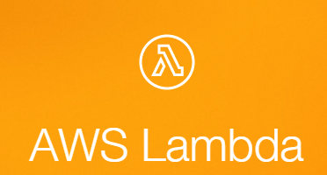
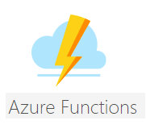
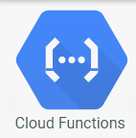
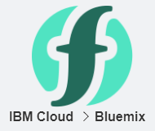
Server Less Computing

Slide 2
Agenda
Overview of Server Less Computing
Why Server Less Computing?
Available Platforms
Demo using Azure – Kudu, Visual Studio, CLI
Gotchas and Limitations with Server Less

Slide 3

My Intro
Baskar Rao
Senior .Net Consultant with Compunnel Software Group.
https://www.linkedin.com/in/baskarrao-dandlamudi
baskarrao.dandlamudi@outlook.com
www.compunnel.com
https://github.com/baskar3078/testazurefunctions

Slide 4

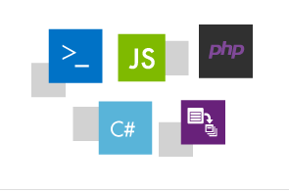
Server Less Computing - Overview
Does not mean No Servers.
Enables developers to develop and execute code with out server provisioning.
“Function as Service” is mainly used to develop event driven applications or perform recurring actions with easier configuration.

Slide 5
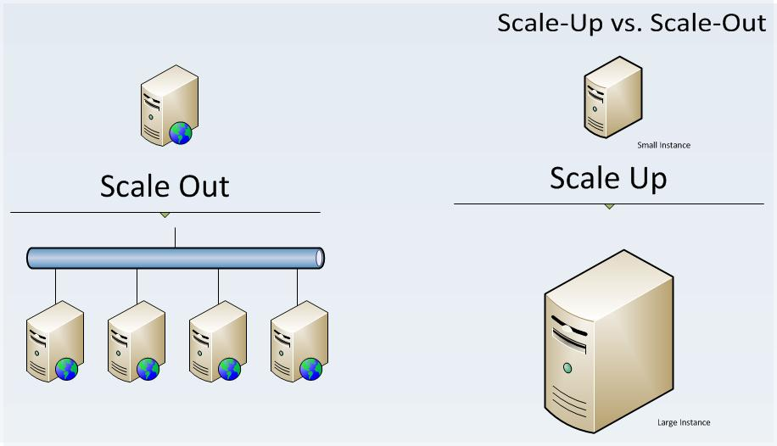
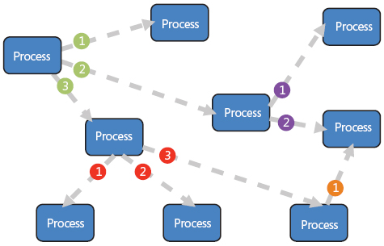
Why Server Less Computing ?
Enables developers to focus on the functionality with out worrying on performance by automatically scaling up or down based on demand.
Allows to pay for only the execution time along with costs for other resources like storage, network etc..
Azure Functions, AWS Lambda, Google Cloud Functions , IBM Cloud Functions are different variations of function as service.

Slide 6
Platform Comparison
 | AWS Lambda | Azure Functions | Google Function | IBM Cloud
Languages | Java , Node.js, C# , Python | C#, F#, Node.js, Python, PHP, Bash, Powershell, Custom exe | JavaScript /Node.js | Javascript/Node.js Swift, Python, Java, Docker (custom)
Triggers | HTTP, Event Based, Scheduled | HTTP, Event Based, Scheduled | HTTP , Event Based ,Scheduled | Event Driven, HTTP
Free Trial | Yes | Yes | Yes | Yes
Free Requests | 1 Million Free Request per month | 1 Million Executions 400,000 GB-s | 400,000 GB-seconds 2 million invocations 5GB of Internet egress traffic | 400,000 GB-s free

Slide 7
Azure Functions- Use Cases

Slide 8
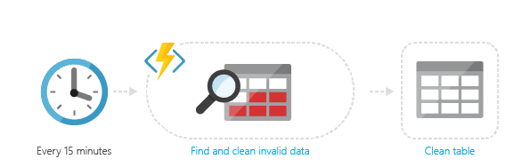
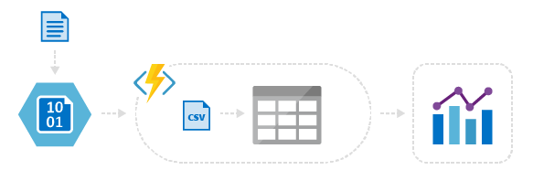
Azure Functions
Timer Based Processing – Control the execution of function using Cron Expressions.
Event Based Processing – Respond to Events with in Azure landscape. Blob Storage, Queues etc.
Create Server Less APIs and integrate with Front End and Mobile Apps.

Slide 9
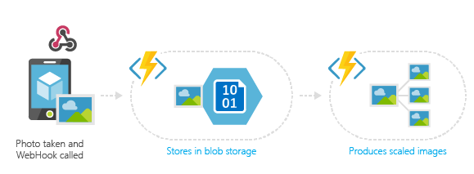
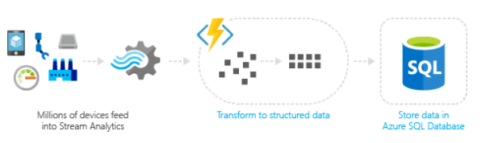
Azure Functions
Respond to Events from IOT Hub and Process Incoming Events.
Respond to GitHub Events using Web Hook.
Integrate with Azure Storage Account , Twilio
and SendGrid for mail communication.

Slide 10
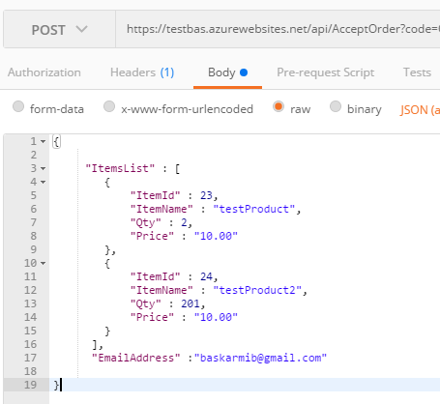
Functions Walkthrough-Azure Portal
Create an Http Trigger Function
Accept order through HttpRequest
Process the request and add an item to Azure Queue
Create an Queue Trigger Function
Save Processed Orders to Processed Orders Queue
Create an Timer Trigger Function
Send an Order Confirmation Email

Slide 11
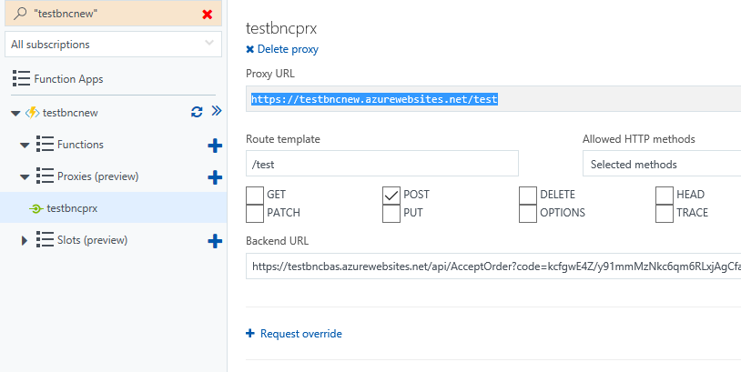
Function Proxies-Azure Portal
Create an Azure Function Proxy
Define proxy route
Configure Back End url
Test the function proxy

Slide 12
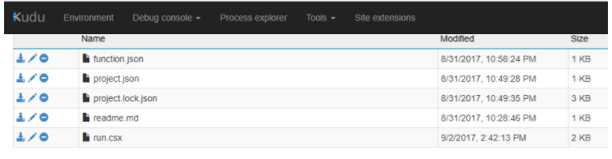
Functions Walkthrough-Using Kudu
Below url can be used to launch kudu explorer
https://functionappname.scm.azurewebsites.net
Kudu can be used to update settings and upload the files.
Example – updating settings to update Nuget Packages.

Slide 13
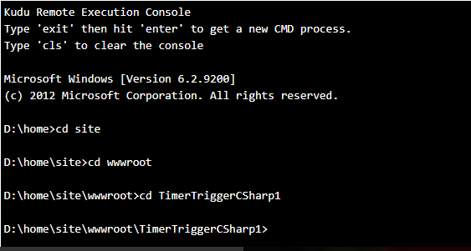
Functions Walkthrough-Using Kudu
Navigate to Debug Console and select cmd.
A command line tool will be enabled.
Using the command line tool,
we can navigate to the folder pertaining
to the above function. Function will be present inside wwwroot.

Slide 14
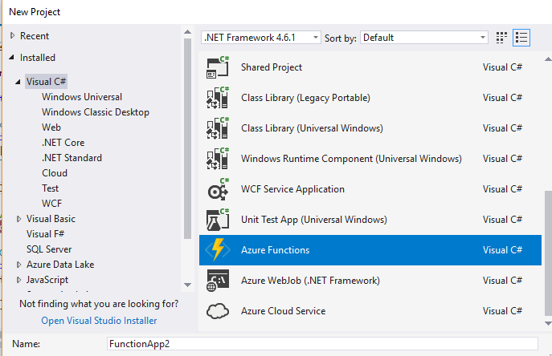
Functions Walkthrough-Visual Studio 2017
Create a function using Visual Studio 2017
Debug a function using Visual Studio 2017
First time debug might take time as
Visual Studio will download Azure CLI tools
After you install or upgrade to Visual Studio 2017 version 15.3, you must manually update the Visual Studio 2017 tools for Azure Functions. You can update the tools from the Tools menu under Extensions and Updates... > Updates > Visual Studio Marketplace > Azure Functions and Web Jobs Tools > Update.

Slide 15
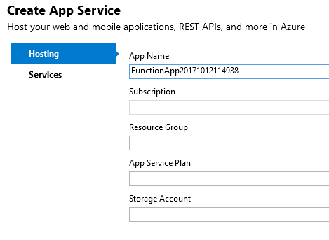
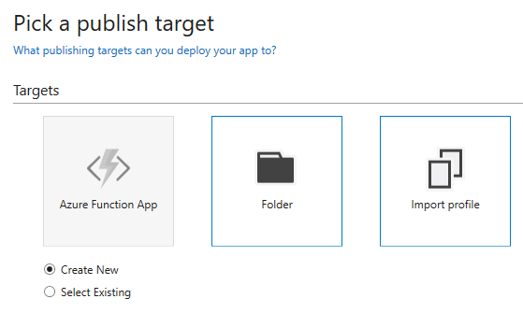
Functions Walkthrough-Visual Studio 2017
Publish a function using Visual Studio 2017
If we publish a function to an existing function app, it is possible that the function settings will be overridden to read only mode. These can be updated in Function app settings in azure portal to make the function in read/write mode in order to use azure portal for development.

Slide 16
Durable Functions
Durable Functions are still in preview mode.
They support the development of stateful functions.
The following patterns are recommended for Durable Functions
Function Chaining
Fan Out and Fan In Pattern
Async Http API and Monitoring
Human Interaction.
Durable Functions are implemented using code workflows.

Slide 17
Key Points to Observe
In azure portal , all the bindings are declared through orchestration or Integrate tab.
Function developed from Visual Studio does not have the integrate tab options in portal.
The method signatures are different in portal and visual studio. VisualStudio it is required to provide the signature attributes.
When we use a Queue Trigger or any event based triggers until the function does not exit gracefully , function will keep on trying to execute the event repeatedly.
As of today Function Proxies and Deployment Slots are in Preview Mode.

Slide 18
Server Less Computing - Limitations
Below are some disadvantages
There might be increase in response time from functions if they are not used continuously.
There is no direct control on the CPU size or Memory allocation as they are allocated based on usage.
They are not suitable to run high performance computing workloads.
There is no source control which can be used to automate deployment of functions if developed using portal.

Slide 19

Questions
https://www.linkedin.com/in/baskarrao-dandlamudi
baskarrao.dandlamudi@outlook.com
https://baskarrao.wordpress.com/
Thanks to the organizers of Orlando Code Camp for giving me an opportunity to present.

